Slide 1
Cédric Lorcé
Orbital Angular Momentum in QCD
IPN Orsay - LPT Orsay
June 27 2013, Dipartimento di Fisica, Universita’ di Pavia, Italy

Slide 2
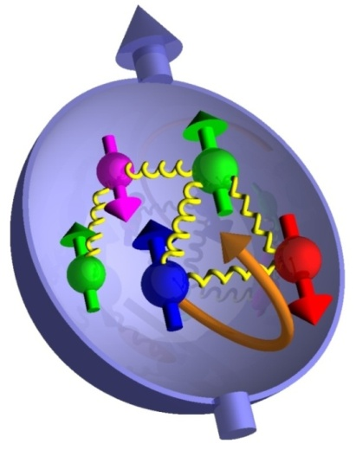
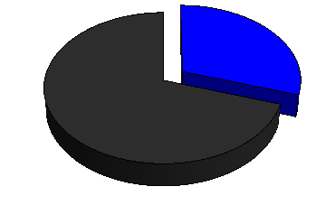
The outline
Basic question
~ 30 %
?
Quark spin
Dark spin
The decompositions in a nutshell
Canonical formalism and Chen et al. approach
Geometrical interpretation of gauge symmetry
Path-dependence and measurability
Conclusions

Slide 3
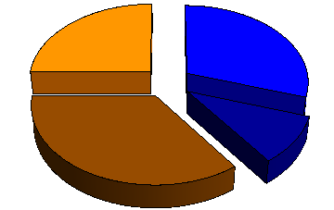
The decompositions in a nutshell
Jaffe-Manohar (1990)
L_{q}
S_{q}
L_{g}
S_{g}
Noether’s theorem

Slide 4
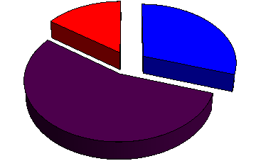
The decompositions in a nutshell
Jaffe-Manohar (1990)
Ji (1997)
L_{q}
S_{q}
L_{q}
S_{q}
L_{g}
S_{g}
J_{g}
Noether’s theorem

Slide 5
The decompositions in a nutshell
Jaffe-Manohar (1990)
Ji (1997)
L_{q}
S_{q}
L_{q}
S_{q}
L_{g}
S_{g}
J_{g}
Noether’s theorem
Chen et al. (2008)
L_{q}
S_{q}
L_{g}
S_{g}
Gauge-invariant extension (GIE)

Slide 6
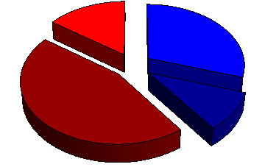
The decompositions in a nutshell
Jaffe-Manohar (1990)
Ji (1997)
L_{q}
S_{q}
L_{q}
S_{q}
L_{g}
S_{g}
J_{g}
Noether’s theorem
Chen et al. (2008)
Wakamatsu (2010)
L_{q}
L_{q}
S_{q}
S_{q}
L_{g}
S_{g}
L_{g}
S_{g}
Gauge-invariant extension (GIE)

Slide 7
The decompositions in a nutshell
Canonical
Kinetic
Jaffe-Manohar (1990)
Ji (1997)
L_{q}
S_{q}
L_{q}
S_{q}
L_{g}
S_{g}
J_{g}
Noether’s theorem
Chen et al. (2008)
Wakamatsu (2010)
L_{q}
L_{q}
S_{q}
S_{q}
L_{g}
S_{g}
L_{g}
S_{g}
Gauge-invariant extension (GIE)

Slide 8
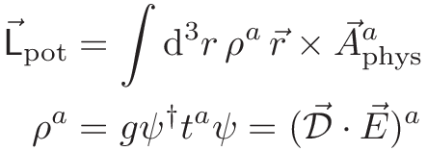
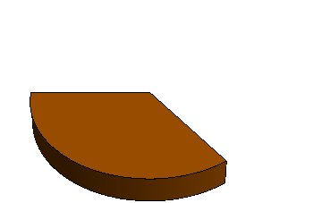
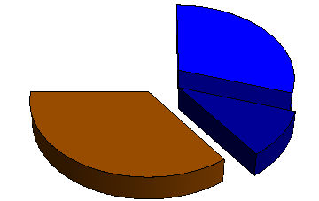
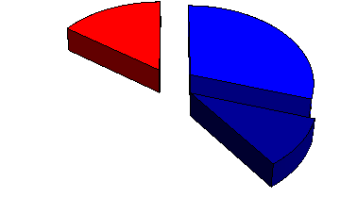
The decompositions in a nutshell
Canonical
Kinetic
Jaffe-Manohar (1990)
Ji (1997)
L_{q}
S_{q}
L_{q}
S_{q}
L_{g}
S_{g}
J_{g}
Noether’s theorem
Chen et al. (2008)
Wakamatsu (2010)
L_{q}
L_{q}
S_{q}
S_{q}
L_{g}
S_{g}
L_{g}
S_{g}
Gauge-invariant extension (GIE)

Slide 9
The Chen et al. approach
[Chen et al. (2008,2009)]
[Wakamatsu (2010,2011)]

Slide 10
The Chen et al. approach
[Chen et al. (2008,2009)]
[Wakamatsu (2010,2011)]
Gauge transformation (assumed)

Slide 11
The Chen et al. approach
[Chen et al. (2008,2009)]
[Wakamatsu (2010,2011)]
Gauge transformation (assumed)
Pure-gauge covariant derivatives

Slide 12
The Chen et al. approach
[Chen et al. (2008,2009)]
[Wakamatsu (2010,2011)]
Gauge transformation (assumed)
Pure-gauge covariant derivatives
Field strength

Slide 13
The canonical formalism
[C.L. (2013)]
Textbook
Lagrangian
Dynamical variables

Slide 14
The canonical formalism
[C.L. (2013)]
Textbook
Lagrangian
Dynamical variables
Gauge covariant

Slide 15
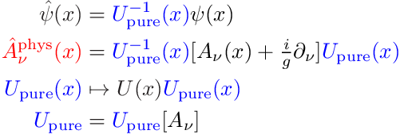
The canonical formalism
[C.L. (2013)]
Textbook
Lagrangian
Dynamical variables
Gauge covariant
Gauge invariant
Dirac variables
[Dirac (1955)]
[Mandelstam (1962)]
Dressing field
Gauge transformation

Slide 16
The analogy with General Relativity
[C.L. (2012,2013)]
Dual role

Slide 17
The analogy with General Relativity
[C.L. (2012,2013)]
Dual role
Pure gauge
Physical polarizations
Degrees of freedom

Slide 18
The analogy with General Relativity
[C.L. (2012,2013)]
Dual role
Pure gauge
Physical polarizations
Degrees of freedom
Parallelism
Curvature
Geometrical interpretation

Slide 19
The analogy with General Relativity
[C.L. (2012,2013)]
Dual role
Pure gauge
Physical polarizations
Degrees of freedom
Parallelism
Curvature
Geometrical interpretation
Inertial forces
Gravitational forces
Analogy with General Relativity

Slide 20
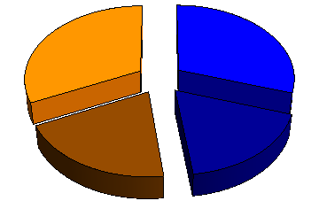
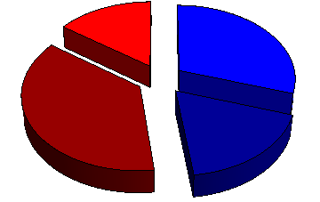
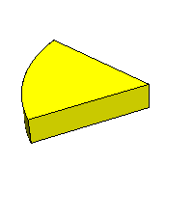
The Stueckelberg symmetry
[Stoilov (2010)]
[C.L. (2013)]
Ambiguous!
Infinitely many possibilities!
Coulomb GIE
L_{q}
L_{q}
S_{q}
S_{q}
L_{pot}
L_{g}
S_{g}
L_{g}
S_{g}
[Chen et al. (2008)]
[Wakamatsu (2010)]
Light-front GIE
L_{q}
S_{q}
L_{q}
S_{q}
L_{pot}
L_{g}
S_{g}
L_{g}
S_{g}
[Hatta (2011)]
[C.L. (2013)]

Slide 21
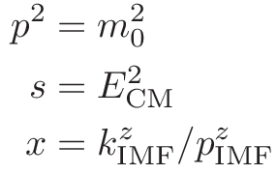
The gauge-invariant extension (GIE)
Gauge-variant operator
GIE2
GIE1
Gauge
« Natural » gauges
Rest
Center-of-mass
Infinite momentum
~
Lorentz-invariant extensions
« Natural » frames

Slide 22
The geometrical interpretation
[Hatta (2012)]
[C.L. (2012)]
Parallel transport

Slide 23
The geometrical interpretation
[Hatta (2012)]
[C.L. (2012)]
Parallel transport

Slide 24
The geometrical interpretation
[Hatta (2012)]
[C.L. (2012)]
Parallel transport
Non-local !

Slide 25
The geometrical interpretation
[Hatta (2012)]
[C.L. (2012)]
Parallel transport
Path dependent !
Non-local !
Stueckelberg symmetry

Slide 26
The path dependence
[Ji, Xiong, Yuan (2012)]
[Hatta (2012)]
[C.L. (2013)]
Canonical quark OAM operator

Slide 27
The path dependence
[Ji, Xiong, Yuan (2012)]
[Hatta (2012)]
[C.L. (2013)]
Canonical quark OAM operator
Light-front
L_{q}
ISI
FSI
Drell-Yan
SIDIS
Naive T-even

Slide 28
The path dependence
[Ji, Xiong, Yuan (2012)]
[Hatta (2012)]
[C.L. (2013)]
Canonical quark OAM operator
Light-front
x-based Fock-Schwinger
L_{q}
L_{q}
ISI
FSI
Drell-Yan
SIDIS
Coincides locally with kinetic quark OAM
Naive T-even

Slide 29
The gauge symmetry
[C.L. (in preparation)]
Quantum electrodynamics
« Physical »
« Background »

Slide 30
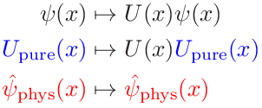
The gauge symmetry
[C.L. (in preparation)]
Quantum electrodynamics
« Physical »
« Background »
Passive

Slide 31
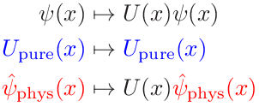
The gauge symmetry
[C.L. (in preparation)]
Quantum electrodynamics
« Physical »
« Background »
Passive
Active

Slide 32
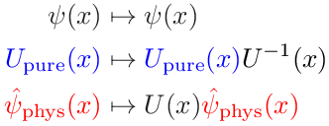
The gauge symmetry
[C.L. (in preparation)]
Quantum electrodynamics
« Physical »
« Background »
Passive
Active
Active x (Passive)⁻¹

Slide 33
The gauge symmetry
[C.L. (in preparation)]
Quantum electrodynamics
« Physical »
« Background »
Stueckelberg
Passive
Active
Active x (Passive)⁻¹

Slide 34
The semantic ambiguity
Quid ?
« physical »
« measurable »
« gauge invariant »

Slide 35
The semantic ambiguity
Quid ?
« physical »
« measurable »
« gauge invariant »
Observables
Measurable, physical, gauge invariant (active and passive)
E.g. cross-sections

Slide 36
The semantic ambiguity
Quid ?
« physical »
« measurable »
« gauge invariant »
Observables
Measurable, physical, gauge invariant (active and passive)
E.g. cross-sections
Path
Stueckelberg
Background
Expansion scheme
dependent
E.g. collinear factorization

Slide 37
The semantic ambiguity
Quid ?
« physical »
« measurable »
« gauge invariant »
Observables
Measurable, physical, gauge invariant (active and passive)
E.g. cross-sections
Path
Stueckelberg
Background
Expansion scheme
dependent
E.g. collinear factorization
Quasi-observables
« Measurable », « physical », « gauge invariant » (only passive)
E.g. parton distributions

Slide 38
The observability
Observable
Quasi-observable
Not observable
Canonical
Kinetic
[Jaffe-Manohar (1990)]
[Ji (1997)]
L_{q}
S_{q}
L_{q}
S_{q}
L_{g}
S_{g}
J_{g}
[Chen et al. (2008)]
[Wakamatsu (2010)]
L_{q}
L_{q}
S_{q}
S_{q}
L_{g}
S_{g}
L_{g}
S_{g}

Slide 39
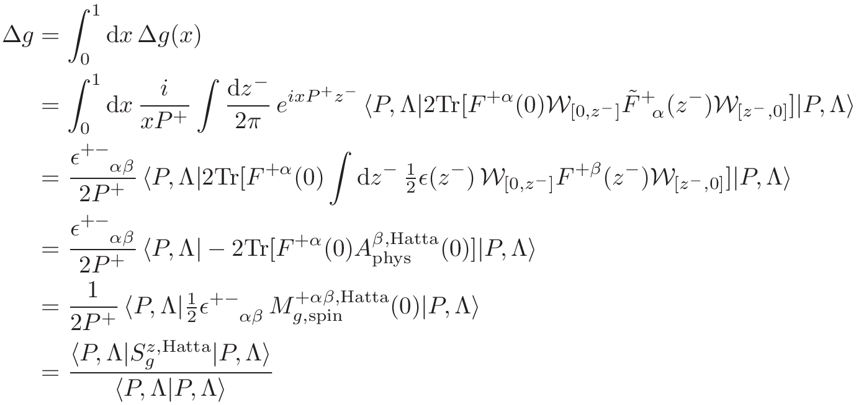
The gluon spin
Gluon helicity distribution
« Measurable », gauge invariant but non-local
Light-front gauge
Light-front GIE
[Jaffe-Manohar (1990)]
[Hatta (2011)]
Local fixed-gauge interpretation
Non-local gauge-invariant interpretation

Slide 40
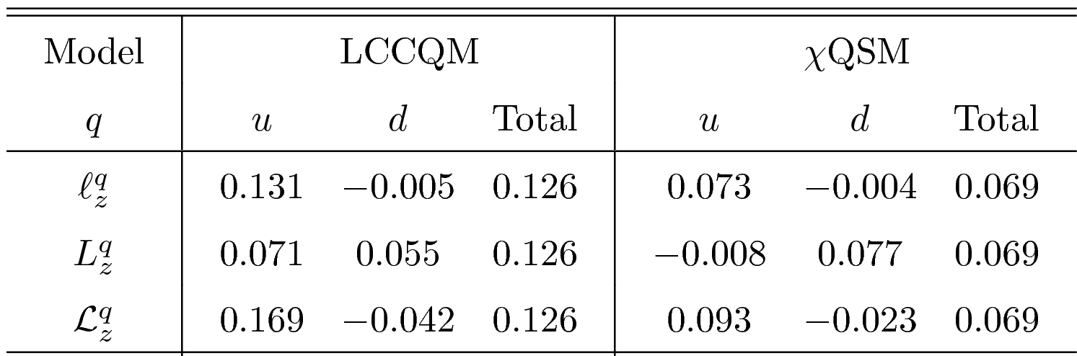
The kinetic and canonical OAM
Kinetic OAM (Ji)
[Ji (1997)]
[Penttinen et al. (2000)]
[Kiptily, Polyakov (2004)]
[Hatta (2012)]
Pure twist-3
Quark naive canonical OAM (Jaffe-Manohar)
[Burkardt (2007)]
[Efremov et al. (2008,2010)]
[She, Zhu, Ma (2009)]
[Avakian et al. (2010)]
[C.L., Pasquini (2011)]
Model-dependent !
Canonical OAM (Jaffe-Manohar)
[C.L., Pasquini (2011)]
[C.L., Pasquini, Xiong, Yuan (2012)]
[Hatta (2012)]
No gluons and not QCD EOM!
but
[C.L., Pasquini (2011)]

Slide 41
The conclusion
Canonical
Kinetic
Jaffe-Manohar (1990)
Not observable
Ji (1997)
Observable
L_{q}
S_{q}
L_{q}
S_{q}
L_{g}
S_{g}
J_{g}
Chen et al. (2008)
Quasi-observable
Wakamatsu (2010)
Quasi-observable
L_{q}
L_{q}
S_{q}
S_{q}
L_{g}
S_{g}
L_{g}
S_{g}

Slide 42
Backup slides

Slide 43
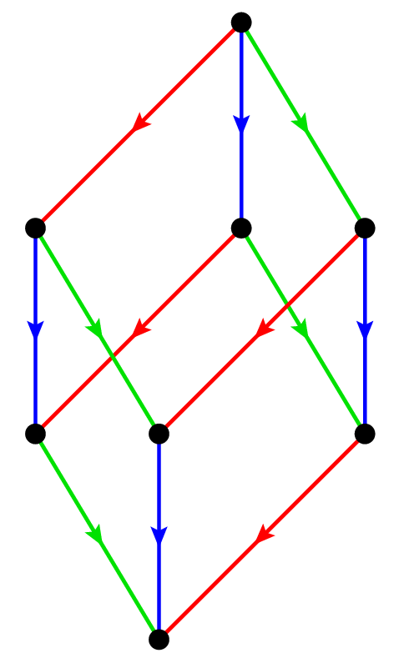
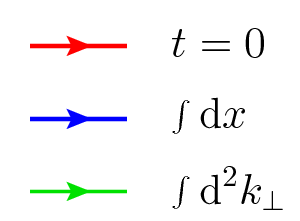
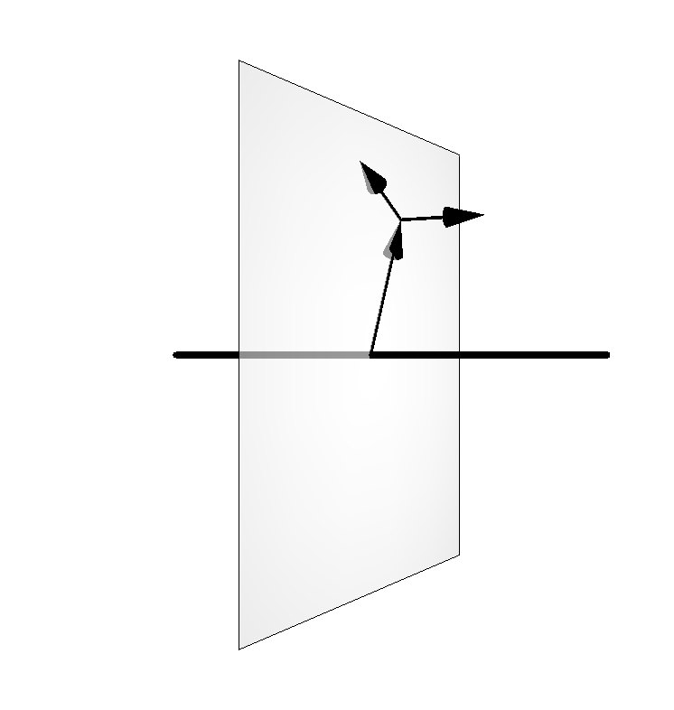
The parton distributions
GTMDs
[PRD84 (2011) 014015]
[PRD85 (2012) 114006]
[PRD84 (2011) 034039]
[PLB710 (2012) 486]
TMDs
TMFFs
GPDs
[JHEP1105 (2011) 041]
TMCs
PDFs
FFs
[PRD79 (2009) 014507]
[Nucl. Phys. A825 (2009) 115]
[PRL104 (2010) 112001]
[PRD79 (2009) 113011]
Charges
Phase-space densities
[PRD74 (2006) 054019]
[PRD78 (2008) 034001]
[PRD79 (2009) 074027]

Slide 44
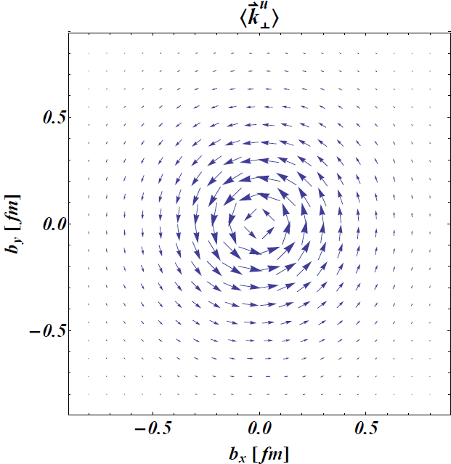
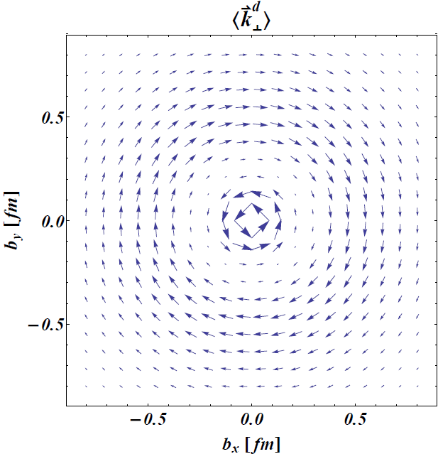
The twist-2 OAM
[C.L., Pasquini (2011)]
[C.L., Pasquini, Xiong, Yuan (2012)]
[Hatta (2012)]
Quark Wigner operator
Quark OAM operator
Exact relation
« Vorticity »

Slide 45
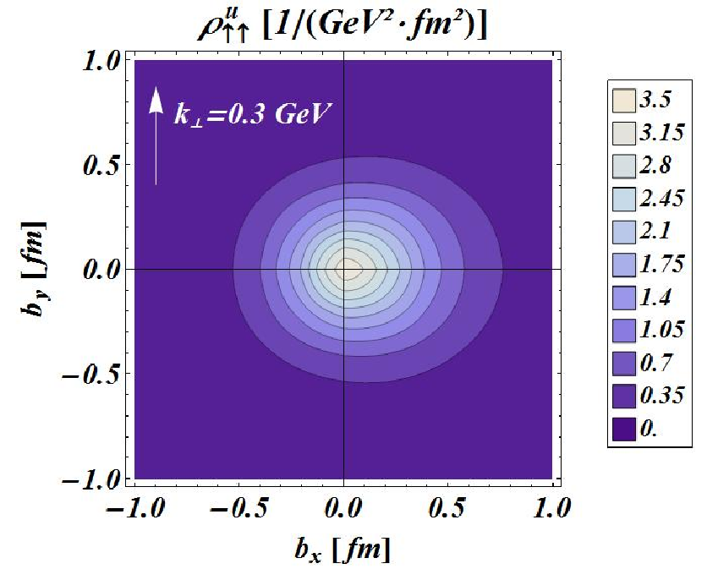
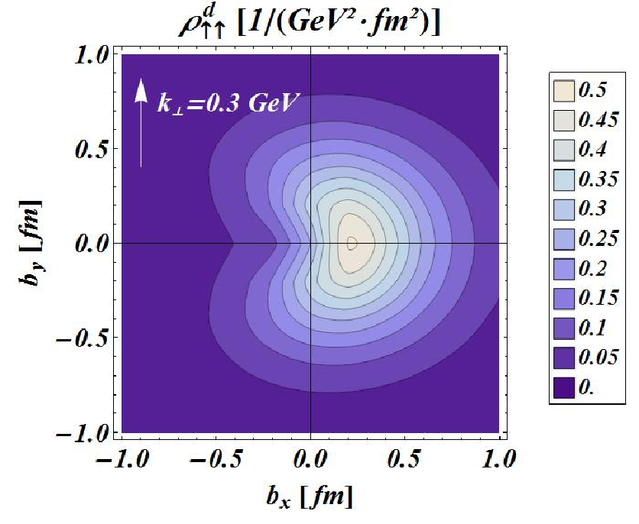
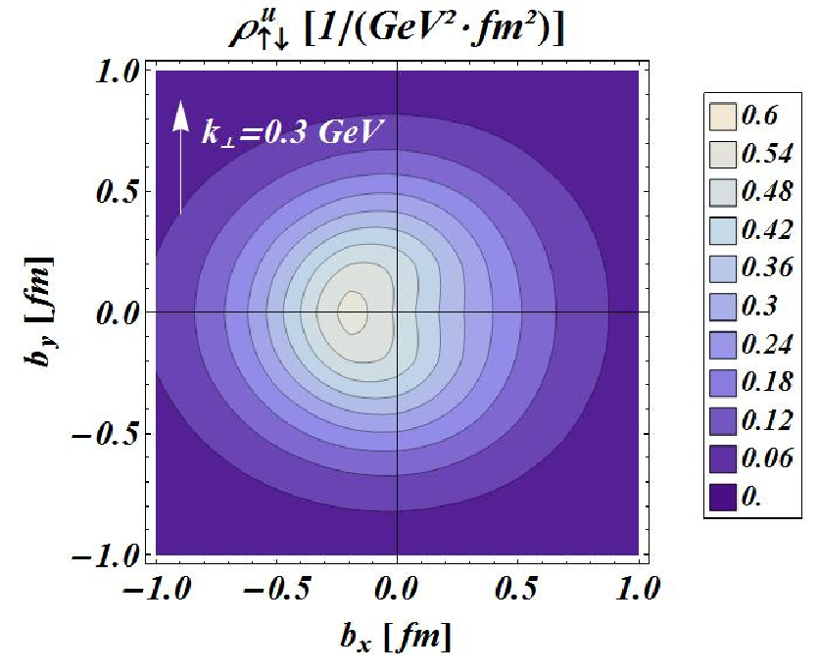
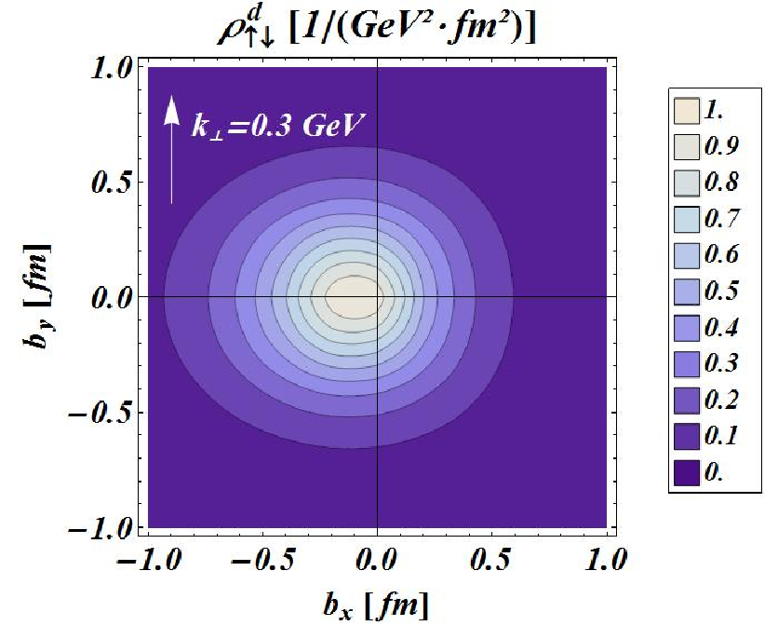
The spin-spin-orbit correlations
[C.L., Pasquini (2011)]

Slide 46
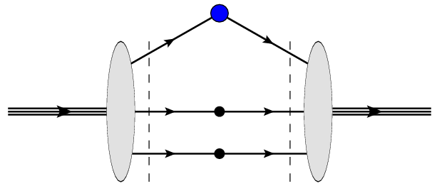
The light-front wave functions
Overlap representation
Momentum
Polarization
Light-front quark models
Wigner rotation
[PRD74 (2006) 054019]
[PRD78 (2008) 034001]
[PRD79 (2009) 074027]

Slide 47
The orbital angular momentum
OAM
Kinetic
GPDs
Canonical (naive)
TMDs
Canonical
GTMDs
Phenomenological comparison
but

